Slide 1
Storyboard Presentation
By
Team : ASTRAL ADVENTURERES

Slide 2
Hall Management Center (HMC)
Team Members :
1. Sameena Banu – (R190736)
2. Harshitha – (R190734)
3. Poojitha – (R190691)
4. Santhosh – (R191031)
5. Girivardhan – (R190139)

Slide 3
Agenda
Introduction
Purpose of HMC
Story Board
Conclusion

Slide 4
Introduction
Purpose
To access and display the details stored in the database, which are entered by students, wardens, mess managers, and the Chairman, and present this data to the Chairman of HMC.
Efficiency: Automate administrative tasks to streamline operations, reducing manual effort and errors.
Student Experience: : Enhance the overall hostel experience by simplifying room allocations and mess charges.
Financial Management: Ensure transparency in financial transactions, including mess charge collection and grant distribution.
Complaint Resolution: Provide a web-based system for recording, addressing, and tracking student complaints, leading to improved satisfaction.
Staff Management: Simplify the management of temporary staff, from leave tracking to payroll calculations.

Slide 5
Introduction
Expense Tracking: Efficiently record and manage petty expenses, ensuring financial transparency.
Data Accessibility: Enable real-time access to critical information for wardens and administrators, supporting data-driven decisions.
Audit and Accountability: Generate accurate financial reports, aiding in annual audits and financial transparency.
Security: Implement robust security measures to prevent fraud and safeguard sensitive data.
Efficiency and Scalability: Ensure the software can handle a large number of students and staff without significant downtime.
Institute Reputation: Contribute to the positive reputation of the institute by providing efficient and transparent hostel services to students.

Slide 6

Story Board - Back Story
The Chairman of the Hall Management Center (HMC) has received an order from the Director of the Indian Institute of Technology (IIT) to provide comprehensive information regarding students, room allocations, financial transactions, including money transfers and mess charges and other related data.
This information is currently stored in physical written formats, making it challenging to present and share with the Director.
In response to this request, the Chairman of HMC is seeking a software solution to streamline and automate various book-keeping activities associated with its day-to-day operations.
By implementing our software, the Hall Management Center (HMC) can efficiently address this issue, enabling the Chairman to readily present the required details to the Director.
User

Slide 7
Interface of Software Administration Point of view

Slide 8
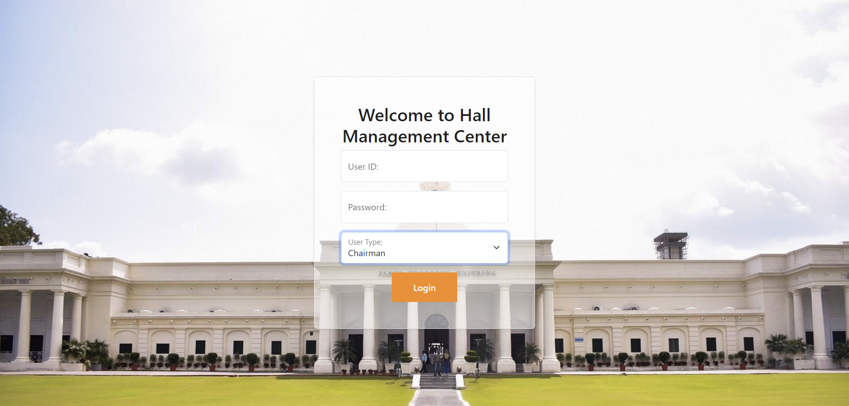
Login Page

Slide 9
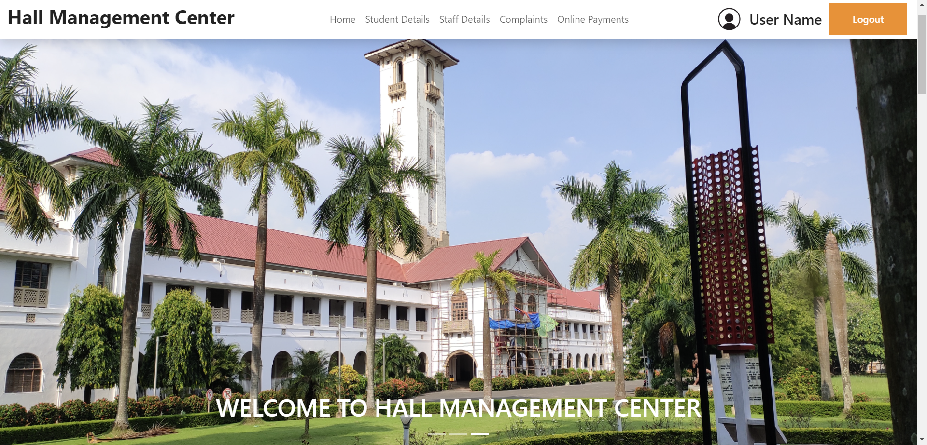
Home Page

Slide 10
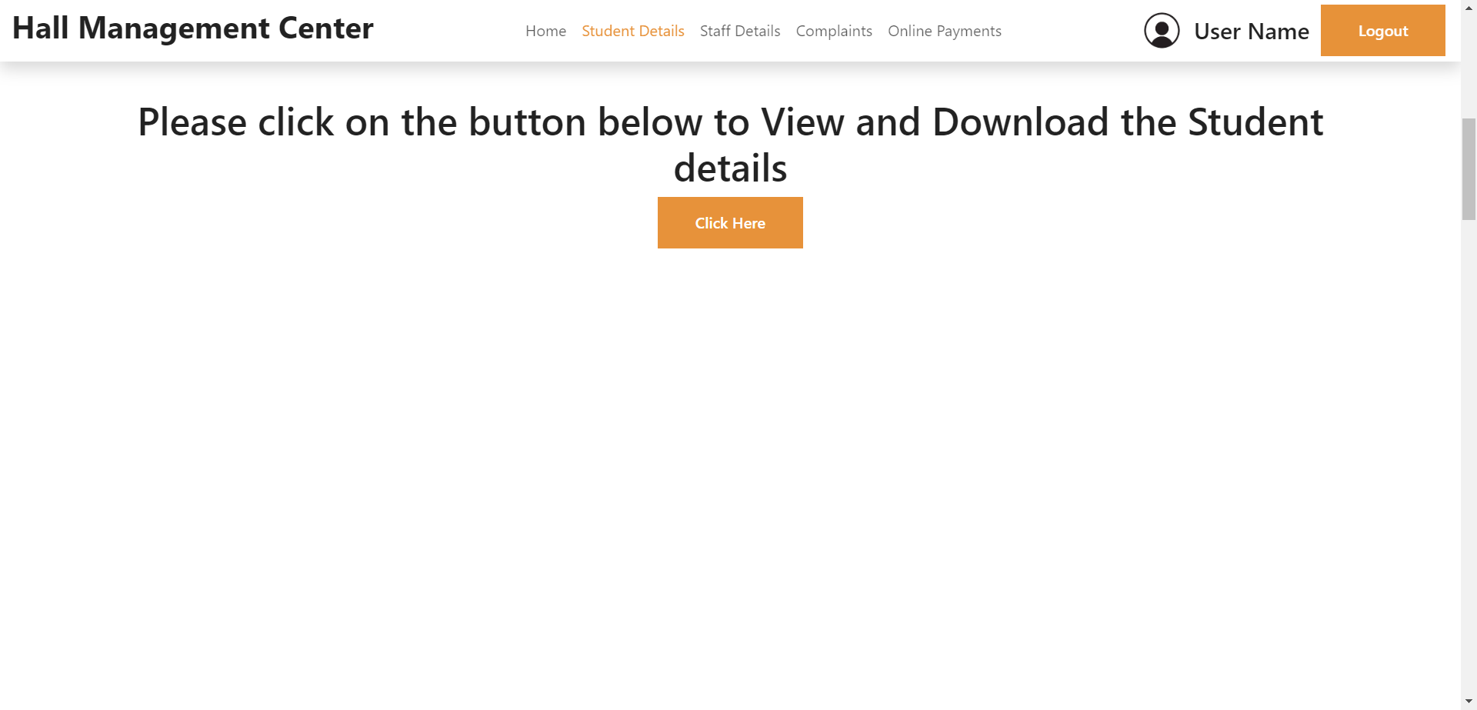
Student Details

Slide 11
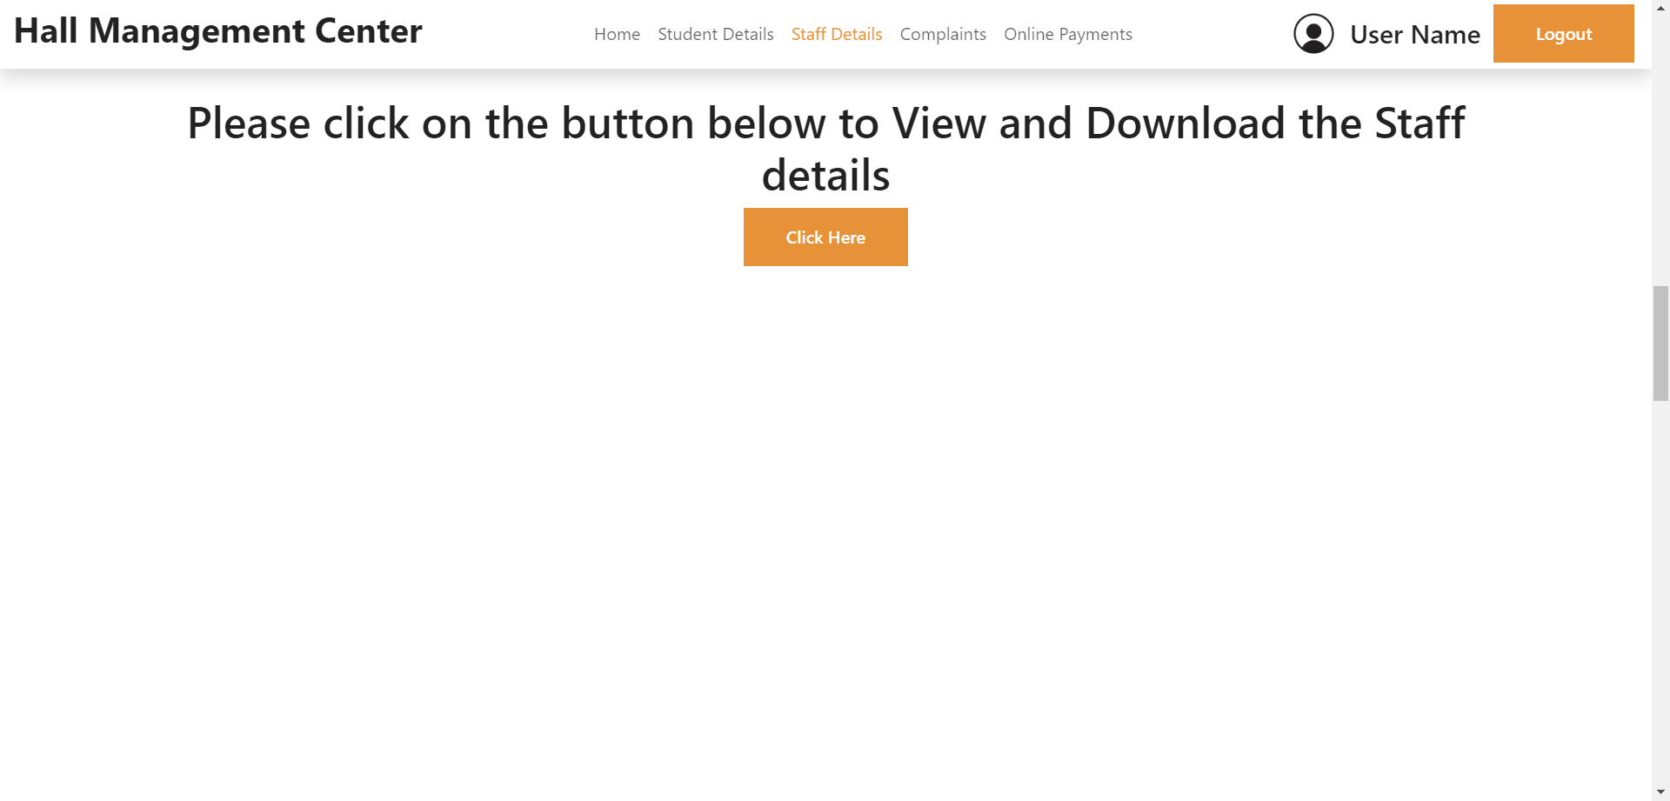
Staff Details

Slide 12
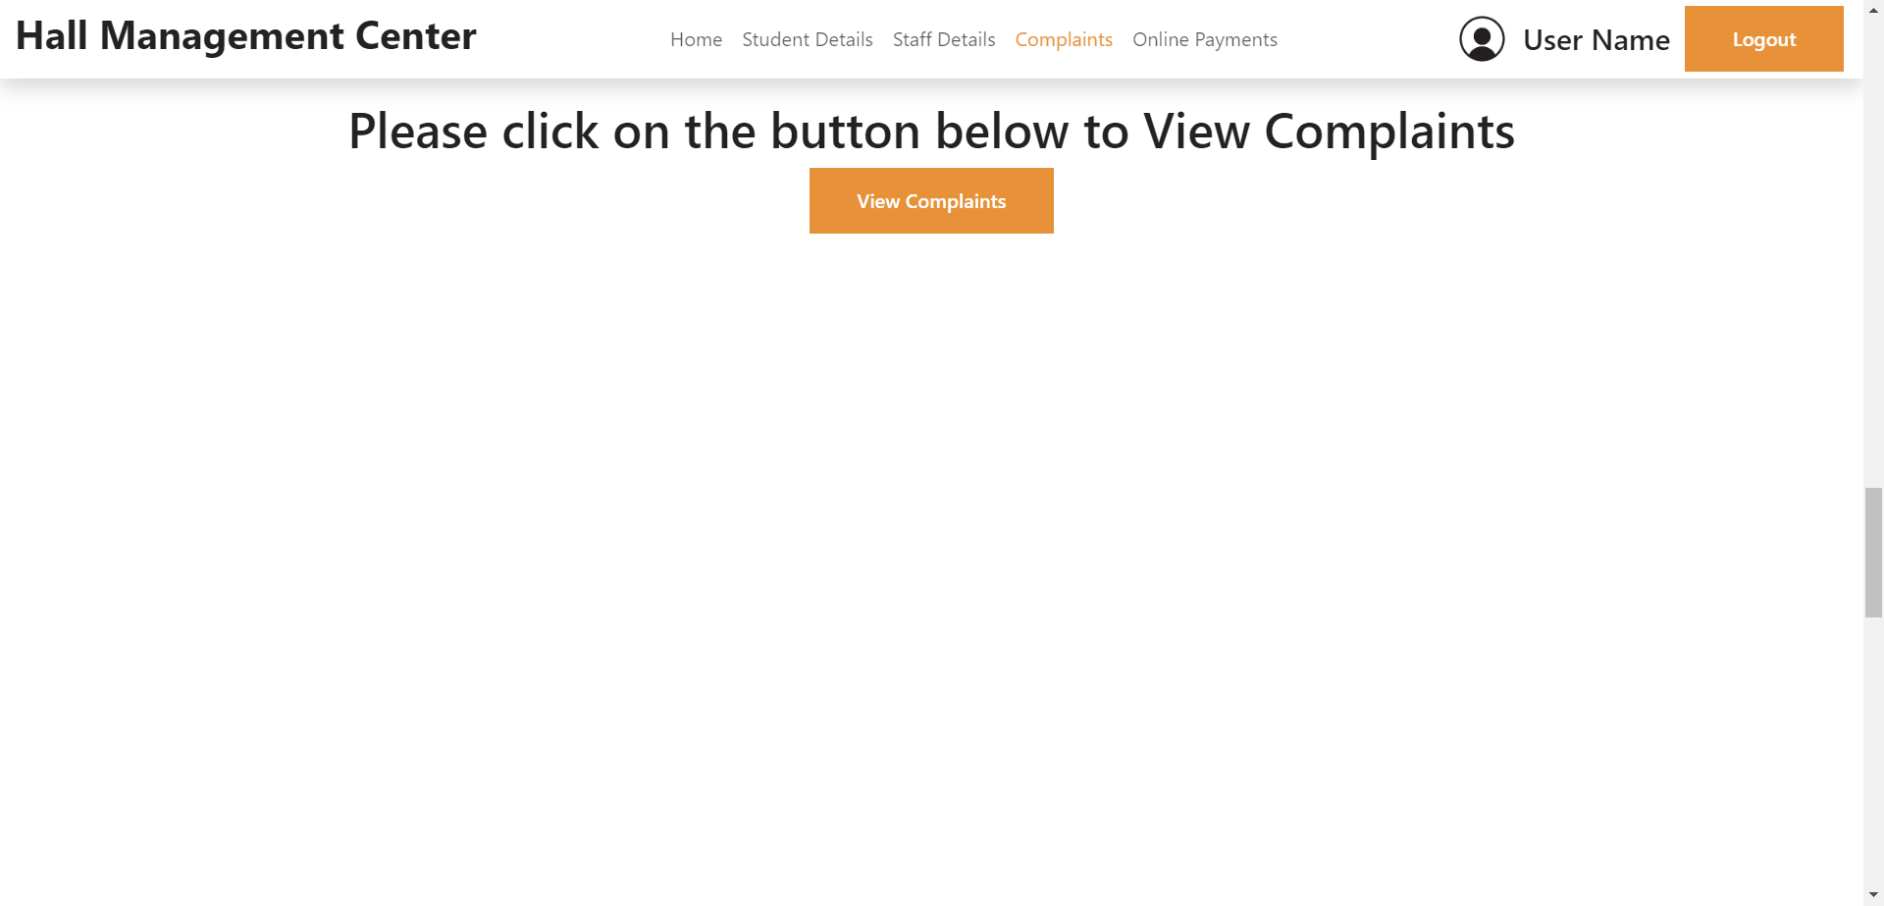
Complaints

Slide 13
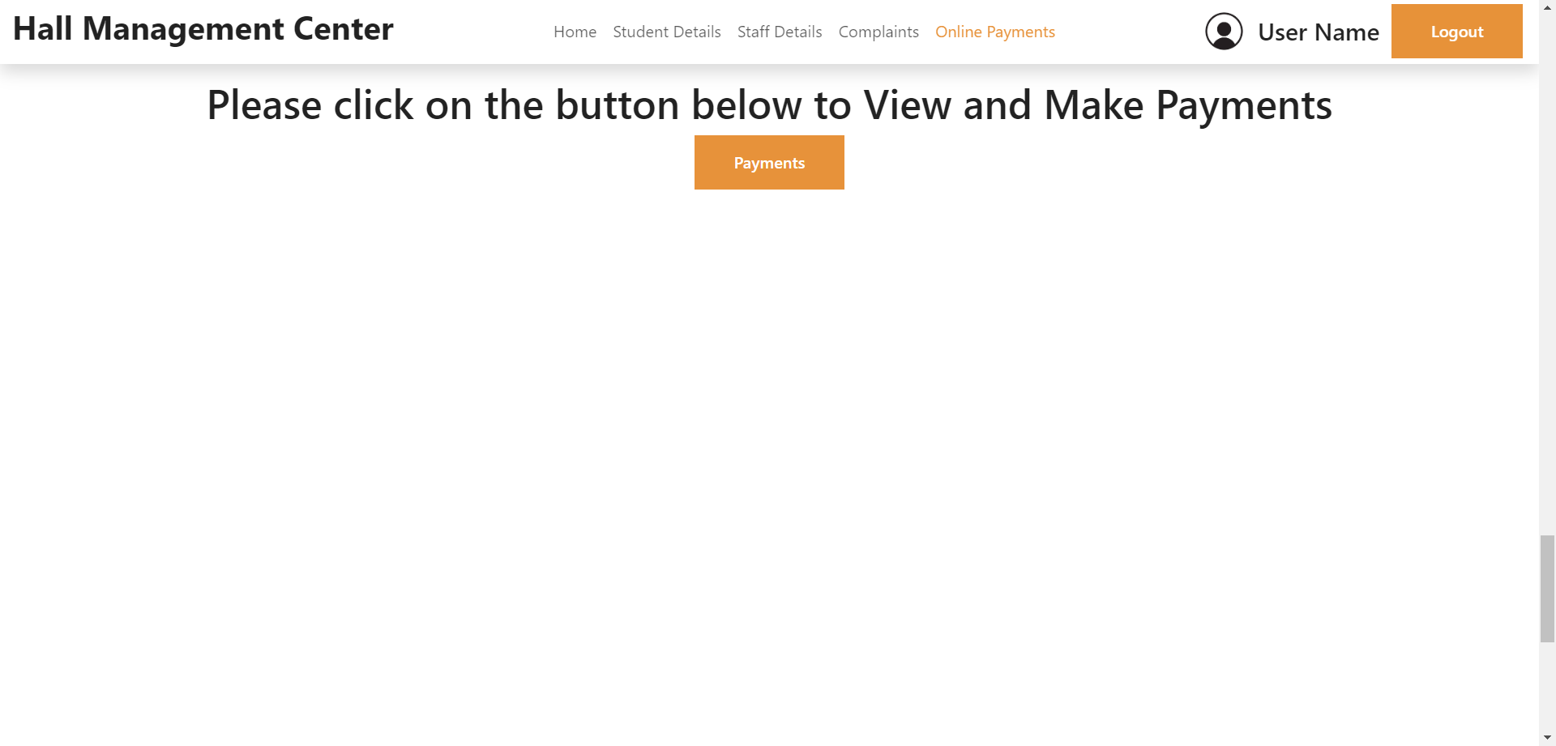
Payments

Slide 14
Interface of Software Student Point of view

Slide 15
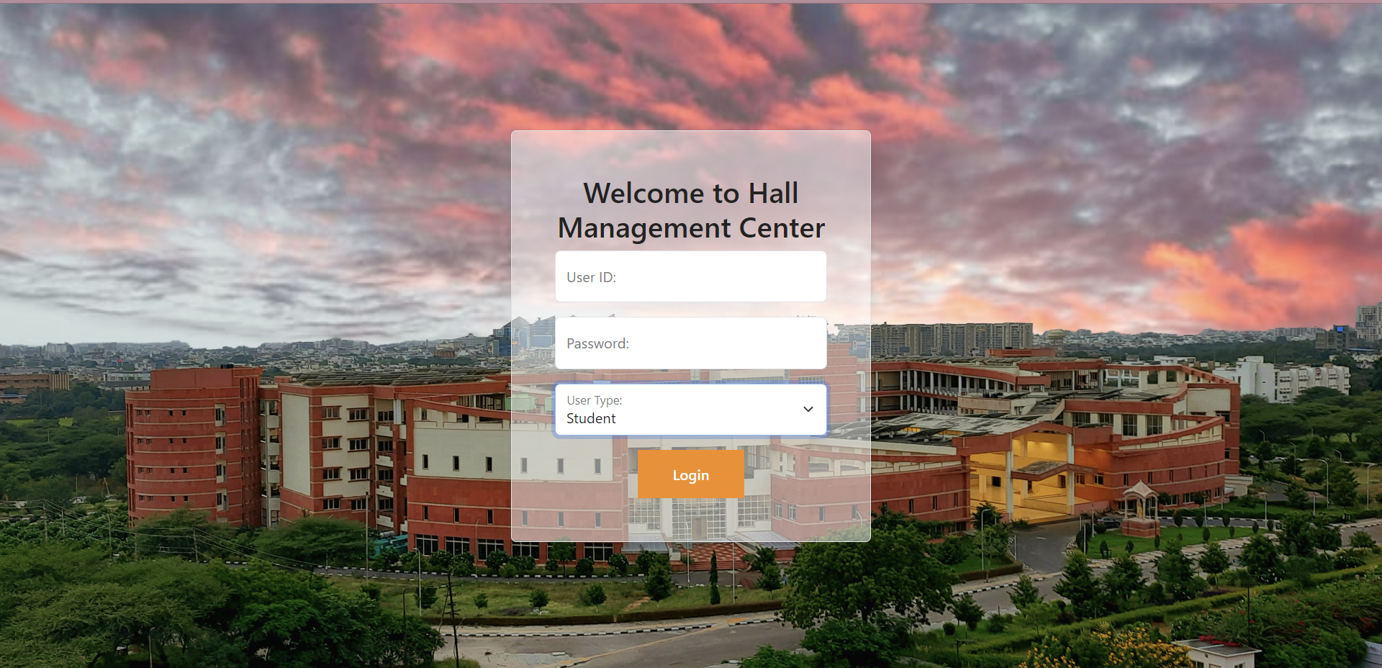
Login Page

Slide 16
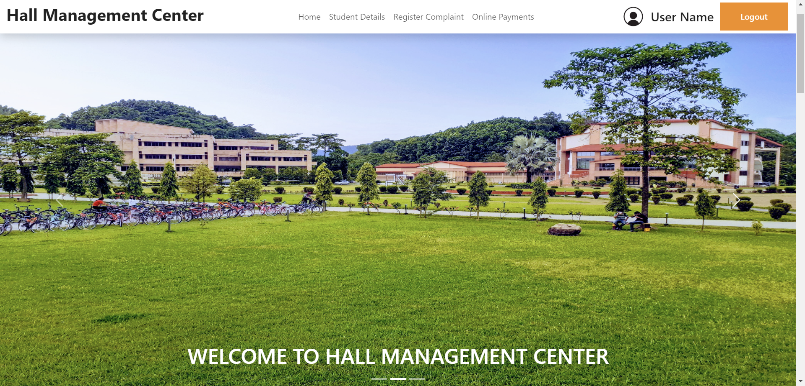
Home Page

Slide 17
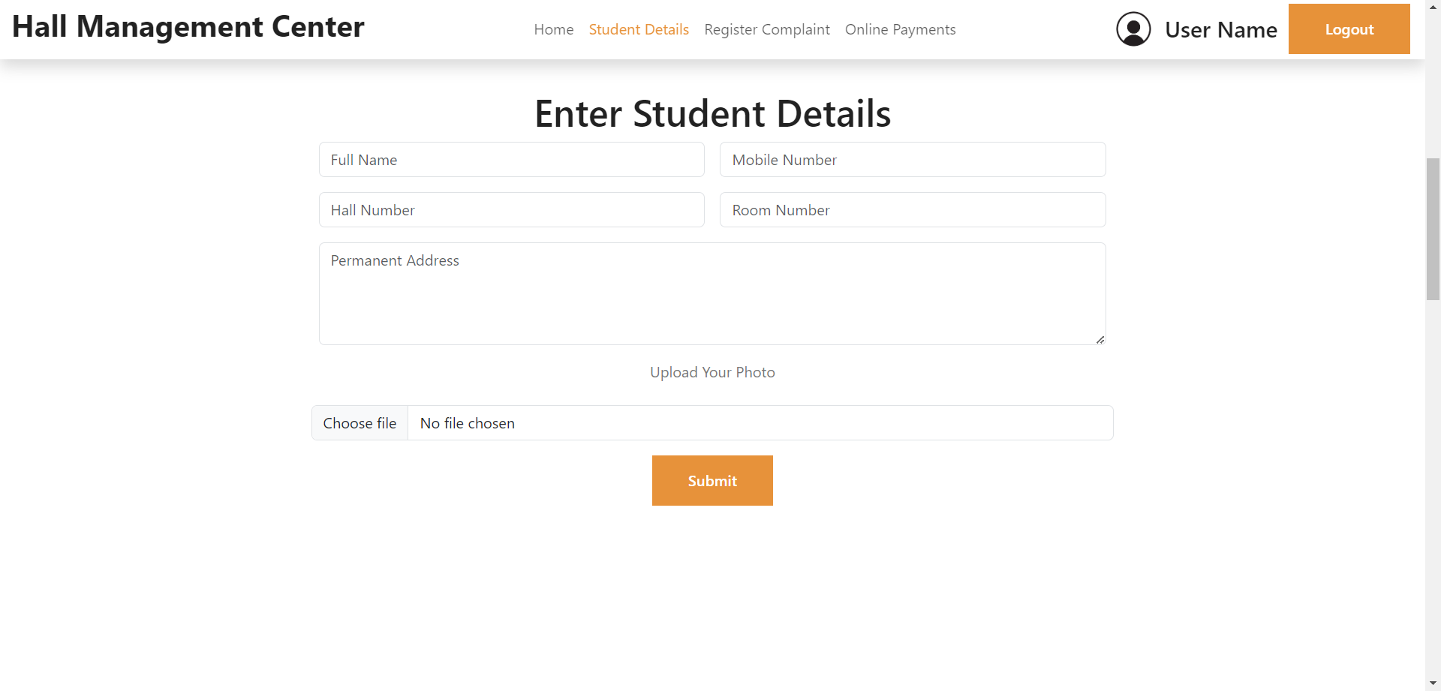
Student Details

Slide 18
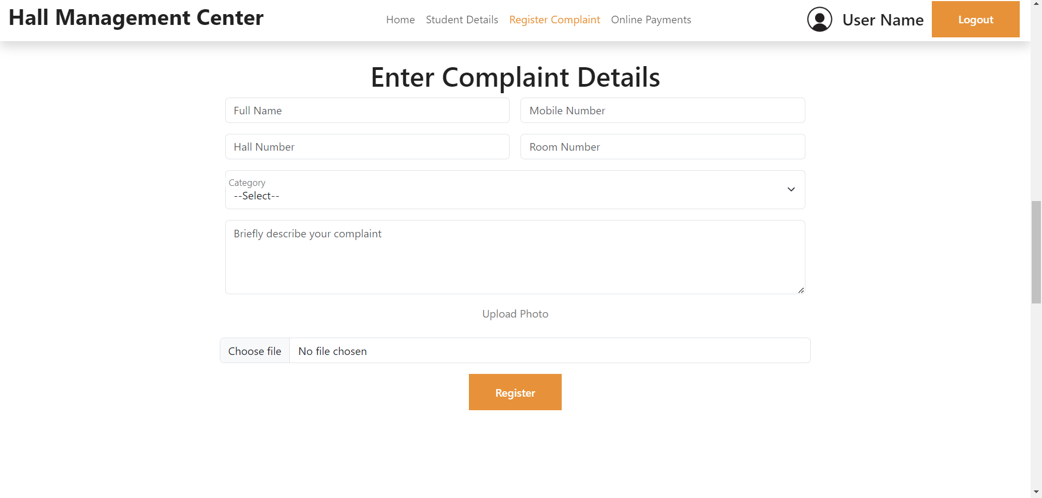
Register Complaint

Slide 19
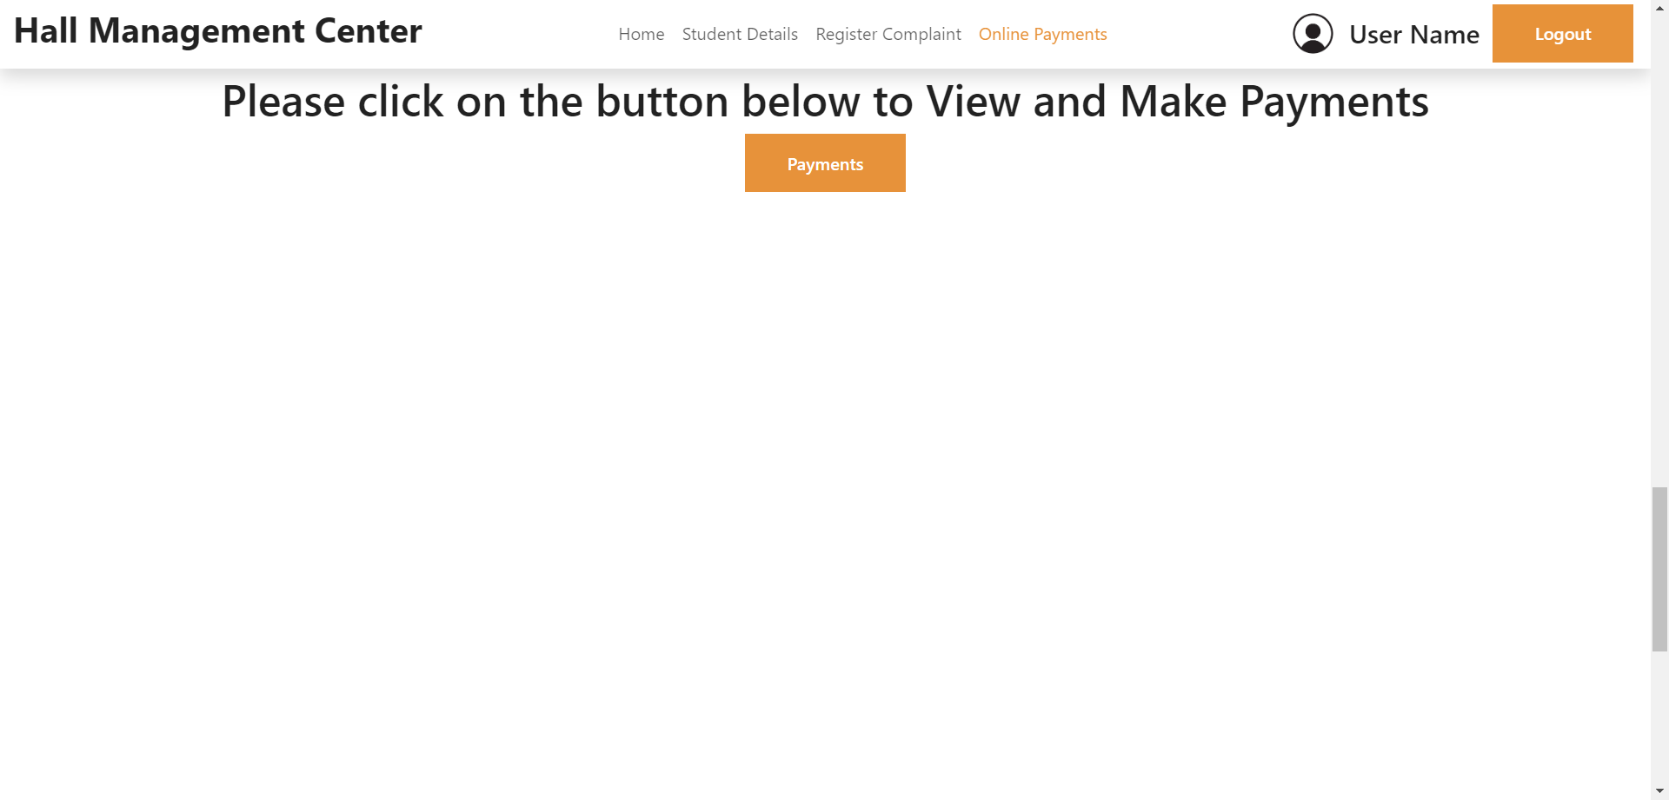
Payments

Slide 20
Conclusion
The software, which we will call the “ Hall Management Center ” Software will offer a user-friendly interface that facilitates the management and retrieval of student records, payment transactions, hostel staff information, and other pertinent data.
This digital solution will ensure accuracy, accessibility, and ease of use, allowing the Chairman to promptly and effectively communicate the necessary information to the Director.

Slide 21
Thank You
Team : ASTRAL ADVENTURERES

